Slide 1
ADAPTATIONS OF THE NEONATE
The first two weeks of life

Slide 2
Definitions
Adaptations – any alteration in the structure or function of an organism or any of its parts that results from natural selection and by which the organism becomes better fitted to survive and multiply in its environment.
Neonate - the name given to the infant during the period of adaptation to life outside the uterus (approx. 2 weeks).

Slide 3
The neonatal period
During this time the end of the umbilical cord is lost, birth weight is regained after initial decrease, and adaptations to new ways of respiration, circulation, digestion, removal of waste products and temperature are made.

Slide 4
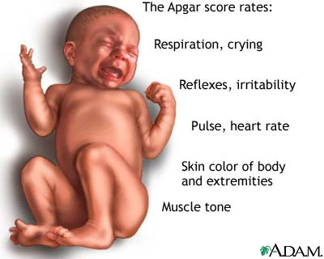
The Apgar Test
The Apgar Test was developed in 1952 and is used to indicate how well the neonate is adapting to life outside the uterus. Assessments are made at 1 minute, 5 minutes and 10 minutes immediately after birth, and uses a scale to 10.
A – appearance (body colour)
P – pulse (heart rate)
G – grimace (reflex irritability)
A – activity (muscle tone)
R – respiration

Slide 5
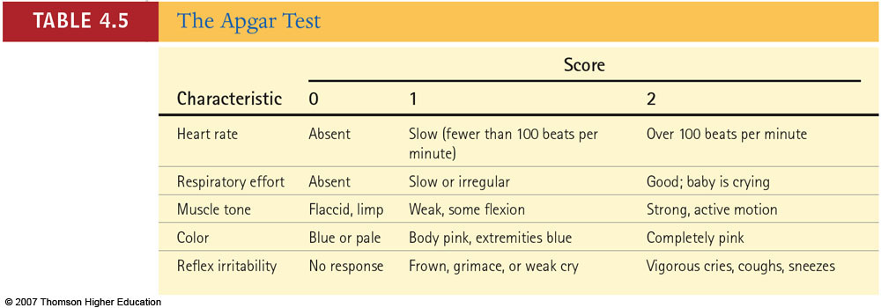
The Apgar rating scale

Slide 6
The Apgar test in action
APGAR testing
Score ratings:
0 – 4 = very poor adaptation
5 – 7 = poor adaptation
8 – 10 = good adaptation

Slide 7
Adaptations of the neonate - circulation
In the uterus, most of the baby's blood circulation bypasses their lungs. This happens through a natural opening in their heart (called the 'foramen ovale'). The opening is covered by a flap of muscle and allows the baby's blood to flow directly to and from their heart to the umbilical cord and the placenta for oxygen, instead of flowing to their lungs. This unique design allows the baby to obtain their oxygen supply (and excrete carbon dioxide), through their mother's blood and her lungs while in the womb.

Slide 8
Adaptations of the neonate - circulation
At birth, the baby's first gasp of air (and to a certain extent the clamping of the cord) causes pressure changes in the baby's lungs. This pressure forces the flap of muscle in the baby's heart to close over the 'foramen ovale' opening. Once this happens, the blood flows away from the umbilical cord to the baby's lungs, causing the blood vessels in the cord to collapse.
Foetal heart circulation

Slide 9
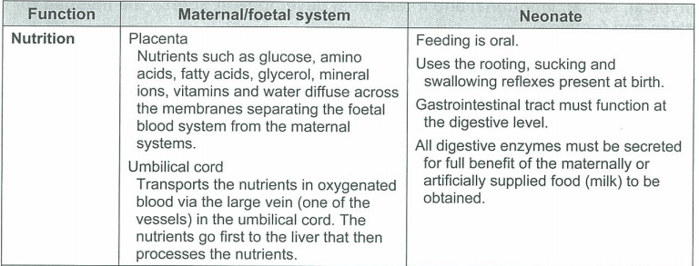
Adaptations of the neonate - nutrition

Slide 10
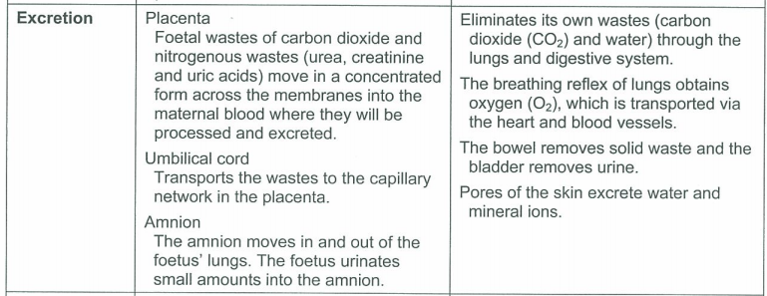
Adaptations of the neonate - excretion
Foetus urinating

Slide 11
Adaptations of the neonate - respiration

Slide 12
Adaptations of the neonate – temperature control
During pregnancy the baby's temperature is kept fairly constant inside the mother's body at about 37.7oC. The baby relies on their mother to sweat and shiver for them (as they are unable to do these things themselves) to keep their own body temperature regulated.

Slide 13
Adaptations of the neonate – temperature control
Once born, babies still have only a limited ability to regulate their own body temperature. Babies can move a little but are unable to shiver. They can sweat, but only the glands in their head, neck hands and feet are active (being about 25 to 30% of their total body size). To keep warm a baby may try to curl up into the fetal position, move or cry (if not covered warmly with clothes or wraps). However, a baby's main source of heat production is their special body fat, known as brown adipose tissue (or 'BAT'). BAT starts to be produced at 26 to 30 weeks of the pregnancy and makes up about 2 to 7 % of the baby's total body weight at birth. BAT is similar to fat tissue found in hibernating animals.

Slide 14
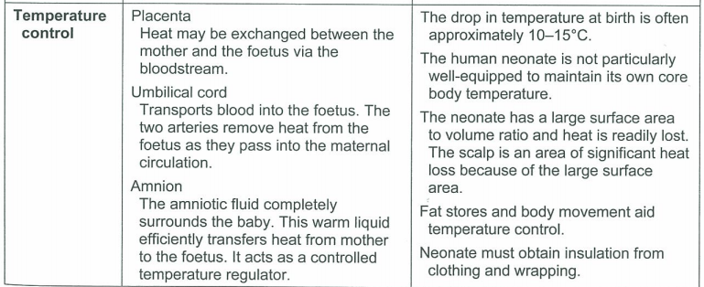
Adaptations of the neonate – temperature control

