Slide 1
Unit 2 – Health & Human Development
Area of study 2 –
Chapter 10 – Understanding adulthood

Slide 2
Defining adulthood as a stage in the lifespan.
Adulthood is defined as “…………….”. (fill in the gaps)
There are 3 sub-stages in adulthood. They are:-
Early Adulthood (18-39 years old)
Middle Adulthood (40-64 years old)
Later Adulthood (65+ years old)

Slide 3
Early adulthood (_____ years old)
Marks transition from youth to adulthood.
Almost finished growth cycle.
Body enters maintenance phase.
No new physical growth but repairing and replacement occurs.
Entitled to vote
Finishing secondary school.
Formation/development of intimate relationships.
Many women are having children.
All changes influence sense of self-esteem.

Slide 4
Middle adulthood (40-64 years old)
Early on often a time of establishing a career.
Toward end of stage it is a time of ending career.
Change occurs for adults as children grow up and move out of family home.
Physically the body is in maintenance.
End of stage decline in muscle strength, sensory organs.
Signs of ageing:-
Greying hair
Decline in vision
Loss of hearing
Loss of teeth

Slide 5
Later adulthood (65+ years old)
In 2008, 13.3% of population was in late adulthood.
Last stage in the lifespan.
Great number of changes in life:-
Retirement from work
Loss of life partners
Introduction of grandchildren
Time for community involvement
Great morbidity and co-morbidities.
Downsizing family homes.

Slide 6
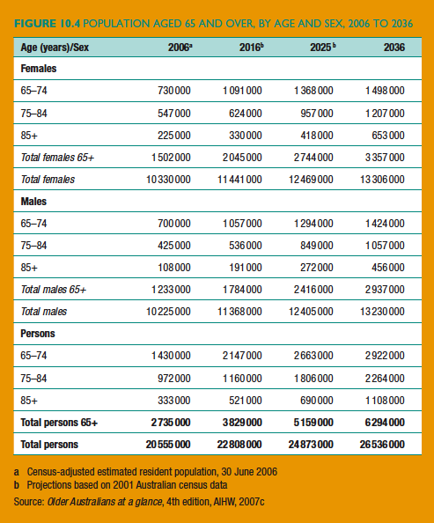
Figure 10.4 – Population aged 65+

Slide 7
Characteristics of physical development

Slide 8
Early adulthood PHYSICAL
Adults achieve peak physical fitness
Maximum muscle strength and endurance
Vision is at peak.
Growth cycle is completed.
Maximum bone mass obtained, maximum height reached.
Body replaces and repairs cells but not as efficiently
Energy requirements start to reduce, the basal metabolic rate slows.

Slide 9
Middle adulthood
Body continues maintenance phase.
Signs of ageing start to show
Males experience:-
reduction in sperm count.
Grey and thinning hair.
Drop in muscle strength
50% increased risk of prostate cancer
Increased risk of stroke and heart attack.
Females experience:-
Menopause (decline in hormones)
Reduced oestrogen levels
Ability to store calcium drops
Greater risk of breast and cervical cancer.

Slide 10
Later adulthood
Efficient functioning of body is in decline.
Changes the began in middle adulthood continue.
New bone conditions.
Joint pain.
Arthritis.
All muscle groups on decline. Including heart and lungs.
This linked to serious health conditions.
Senses continue to decline.
Bones become more brittle. Increase in breaks and fractures.
Further decrease in basal metabolic rate.
By later adulthood body has more body fat than muscle.

Slide 11
Characteristics of social development

Slide 12
Early adulthood SOCIAL
Moving away from family and forming new friendships.
Choosing a life partner
Starting a family
Moving out of family home
Financial independence
Forming strong friendship groups.
Meeting new in-laws.

Slide 13
Middle adulthood
Advancement in career
Leadership opportunities presented
Increased involved in community and volunteer activities.
Raising children
New adult friendships formed.
Some examples would include:-???

Slide 14
Later Adulthood
Become grandparent
Redefinition of self-identity. WHY??
Free time to enjoy travel.
New housing may be needed as independence levels drop (notion of down sizing).
New friends as a result of new housing arrangements (retirement village or nursing homes).

Slide 15
Characteristics of emotional development

Slide 16
Early adulthood EMOTIONAL
Intimate relationships
Self esteem through career, family, $ success.
Support and affection from children
Stress from graduating from university/completion of trade and jobs are difficult to secure.

Slide 17
Middle adulthood
As career and family develop continued self-worth and esteem
Dealing with teenagers and making sure they make good decisions.
Sense of belonging increases
Coping with ageing parents an issue

Slide 18
Later adulthood
Coping with grief of loss of long term friends and life partner
Changes to self-esteem.
Loss of career. What impact will that have?
Seeing children and grandchildren grow and develop.

Slide 19
Characteristics of intellectual development

Slide 20
Early adulthood INTELLECTUAL
Further advanced learning (Uni, tafe, apprenticeship).
Professional development through work.
When starting a family learning all aspects of this new ventureS.
Learning to drive

Slide 21
Middle adulthood
Career knowledge and skills continue to develop.
As children progress through school parental learning must occur.
Might begin to care for life partner or ageing parents this requires new skills.

Slide 22
Later adulthood.
Keeping brain active is key. Card games, crossword, travel, music, dance.
Decline in memory means re-learning something again or maybe a different way of doing things.
Reaction time is slower. Loss of driving privileges, learning bus/train/tram routines.

