Slide 1
Unit 2 Health & Human Development
Area of study 1 –
Chapter
The health of Australian children

Slide 2
Overall Health of children
Most Australian children are healthy.
Concerns however remain in areas of:-
Diabetes (both type 1 & type 2)
Asthma
Mental health problems
Injury
Increase in overweight & obese (associated illnesses)

Slide 3
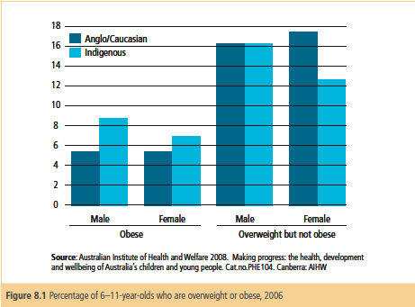
Health concerns & obesity.
Prevalence is increasing.
In 2006, 6% of 6-11 were obese. (page 234)
17% were overweight.
Health complications:-
Blood pressure
Type 2 diabetes
Reflux
Asthma
Muscle
Skeleton
Activity 8.1 questions 1-3

Slide 4
Leading cause of hospitalization
In 2005-06 there were half million children in hospitals.
Leading reason was respiratory conditions.
Over 10 years rates for children 5-12 have dropped.

Slide 5
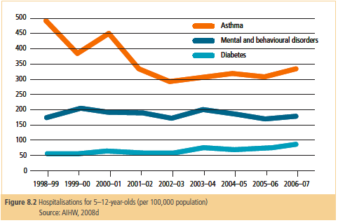

Slide 6
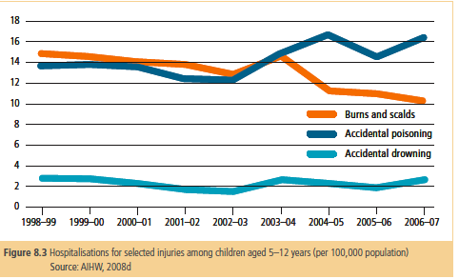

Slide 7
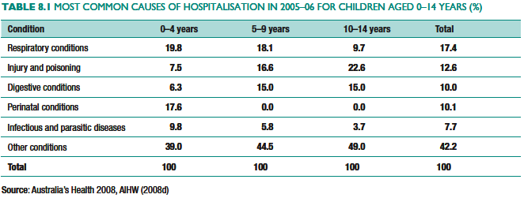

Slide 8
Long term conditions
2004-05, 41% children had long term condition (6 months or more).
AIHW – 12% children diagnosed with asthma
Asthma more common in boys than girls.
Asthma more common in indigenous than not.
Asthma contributes to:-
Missed school
Tiredness
Poor concentration
Poor quality of life.

Slide 9
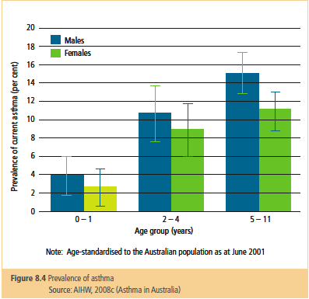

Slide 10
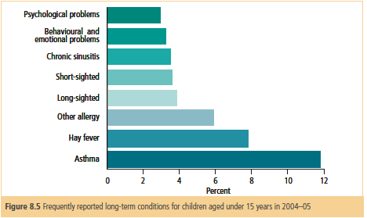

Slide 11
Leading causes of mortality
Death rates have declined in past 20 years.
Communicable diseases injury have largest drops.
2005, 1831 deaths 0-15yr old.
Risk of death greatest in first year of life (70%)
In 2006 infant mortality rates were 4.7 per 1000 live births.
Leading causes of deaths were:-
Perinatal (problems with the birth)
Congenital malformations (chromosomes or genes)

Slide 12
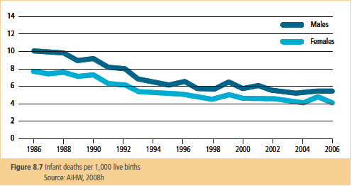

Slide 13
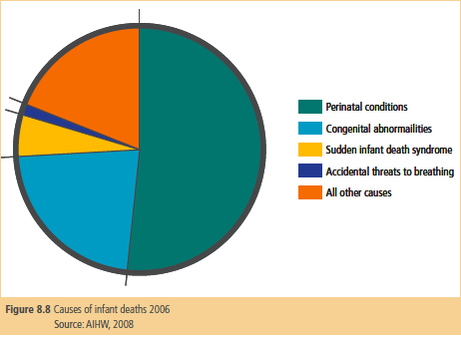

Slide 14
Injuries and poisoning.
Due to curiosity and immaturity children are more susceptible to injury and poisoning.
As physical development improves so to does the risk of falls and injury.
Small and not visible to other drivers
Poor concentration
Where are sounds coming from?
Lack of Intellectual development means
children don’t understand consuming household liquids.
Speed and distance of vehicles (leads to pedestrian injury)
Media Release – Poisons cabinets in ALL new homes. Read article page 241-242 (Activity 8.4)

Slide 15
Aged 1-12 mortality rates higher in boys than girls. Higher in Indigenous community.
Many causes of mortality are preventable. In 2004-05 injury accounted for 38% of deaths:-
Transport injuries (occupants and pedestrians)
Drowning
Fire
burns

Slide 16
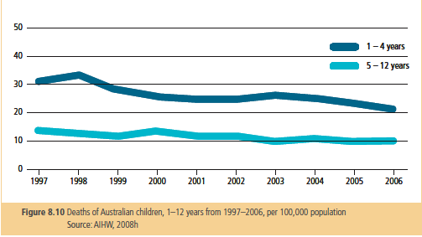

Slide 17
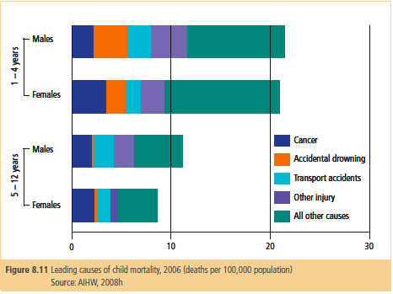

Slide 18
Work.
Complete learning activity 8.5.
Refer to figures 8.7, 8.8, 8.10 and 8.11.
Complete questions 1-4.
Summary questions
Questions 2, 5, 6, 9.
Extension questions
Question 3
Examination preparation questions.
Questions 1 a & b, 2 and 3.

