Slide 1
Unit 2 – Health and human development.
Chapter 9 - Determinants of the health and development of Australian children.

Slide 2
determinants
a determinant is a factor that impacts on the health and development of an individual.
This impact can be positive or negative but it does alter of change the health and development of an individual.

Slide 3
Determinants….
BIOLOGICAL.
Body weight.
W.H.O declared obesity global epidemic.
20-25% children obese (mostly in developED countries)
Health concerns
Blood pressure
Type 2 diabetes
Reflux
Asthma
Joint pain
Social, mental health affected (self esteem, self concept)
In focus (Birth weight page 251)

Slide 4
Determinants….
BEHAVIOURAL.
Vaccination
In focus – Maternal behaviours prior to and during pregnancy (page 261-263 essential for SAC & exam)
Diet - pre, during and post pregnancy significant for mother and baby.
Tobacco smoking – reduces oxygen supply, increase risk of SIDS, asthma, low APGAR.
Alcohol – mental retardation, facial issues, FAS (Foetal Alcohol Syndrome), brain growth small.
Drug Use – illicit or licit cross the placenta, caffeine, vitamins, HIV and AIDS, Hep A, Hep B.
Disease – chicken pox, measles, flu all cross through umbilical cord into the placenta.

Slide 5
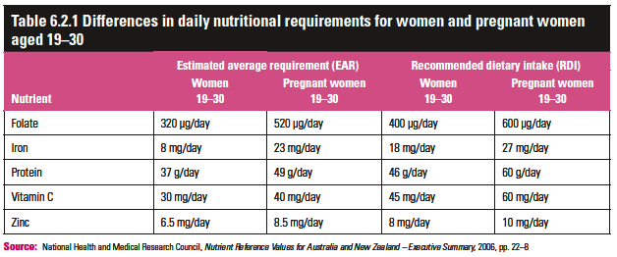
Maternal vitamins & minerals

Slide 6
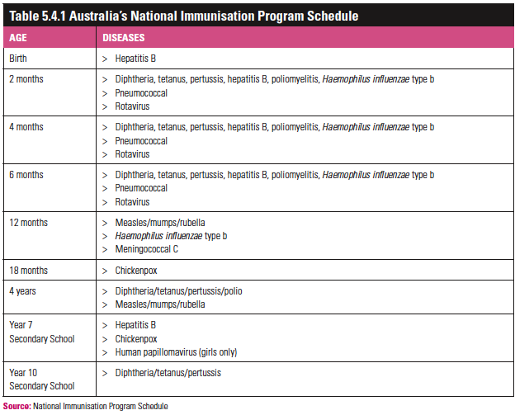
Vaccinations

Slide 7
Determinants…..
PHYSICAL ENVIRONMENT
Water quality – fluoride in the water.
Home environment
In focus – Housing environment (page 268)
Link to low levels of immunisation, self esteem, if poor.
Home is child’s introduction to world.
Place of growth, comfort, safety.
If smoker or drinker in house, environment less safe.
House needs to be kept safe (poisons, water temp, car parking)

Slide 8
Determinants…….
SOCIAL ENVIRONMENT (FAMILY)
Positive parenting
In focus – Work and family life balance (pg 273-275)
Positive parenting important for support.
Helps to resolve conflicts
Work and family life is a balance
Long hours impinge on family life, bonding, safety.
Long hours ensures $ into family, security.
Unemployment is detrimental to health and development of children.

Slide 9
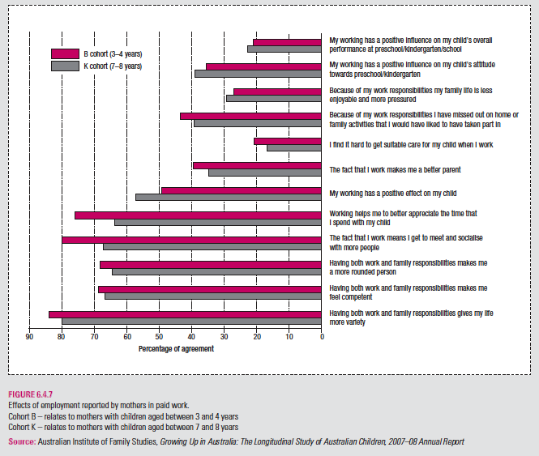

Slide 10
Determinants….
SOCIAL ENVIRONMENT (Community)
Media – young children vulnerable to what they see and hear. (impact both positive & negative)
Children often disturbed by news events and violence (even if it is cartoon).
Access to healthcare has direct impact on both health and development of the individual.
Kindergarten and daycare promotes health and development (table 9.6)
In focus – Access to school. (pages 283 – 284)

Slide 11
Benefits of traditional schooling
Structured classroom setting.
Qualified teaching staff.
Well rounded education.
Social development, sometimes making life long friends.
Problem solving and conflict resolution skills developed , both in and out of class.
Critical thinking, reasoning and abstract thought taught then challenged.
Assessment is continual and support/advice offered for those that are underachieving.

Slide 12
Critics of traditional schooling
Parents have no control over curriculum.
Structure does not suit every child.
Bullying and negative influences can impact on child.
Need to separate from primary caregiver.
Long hours followed by homework.
Parents who want their child removed from sex ed classes are seen as ‘problem parents’.

Slide 13
Benefits of homeschooling
Child can work at own pace.
Parents can control content of curriculum.
Assessment is less stressful as it is being done in warm and inviting environment.
Parents can control religious and sexual content of material being taught.
Bullying and drug influences do not exist.

Slide 14
Critics of homeschooling
Most parents that home school their children are not qualified to teach.
Children that are homeschooled are significantly academically lagging behind their peers. In some instances 2 years behind.
Children are deficient in social and intellectual development.
Are often more depressed as they feel isolated and restricted from making friends and forming friendship groups.
Assessment is not validated to ensure it meets current national standards.
If they enter university that are, mentally, socially and intellectually under-developed.

Slide 15
Work set….
SUMMARY QUESTIONS.
1, 9, 11.
EXTENSION QUESTIONS.
3.
EXAMINATION PREPARATION QUESTION.
1, 2, 3a & b.

